Slide 1


Slide 2

Mir Jeffres
Mir received his Master’s degree in Music Technology at Georgia Tech
Audio applications engineer for Texas Instruments
He can be found hacking electronics, performing live with his homemade synths, and sharing his passion for music and audio

Slide 3

Christine Hoang
Software engineer, maker, synth geek, dj, and musician
Avid supporter of the music community in the Dallas, Texas area through music organizations and events coordination
She can be found programming and hacking for creative and educational pursuits

Slide 4
What are we learning?
Reverse Avalanche Oscillator Synthesis
How to read a circuit schematic
Transistor operation and reverse avalanche breakdown
RC filters and Audio Amplifier
Components and Materials
Building the synth and sound testing

Slide 5
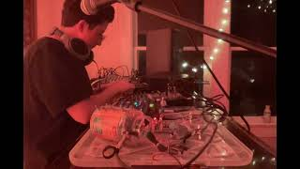
Demo of synthesizer

Slide 6
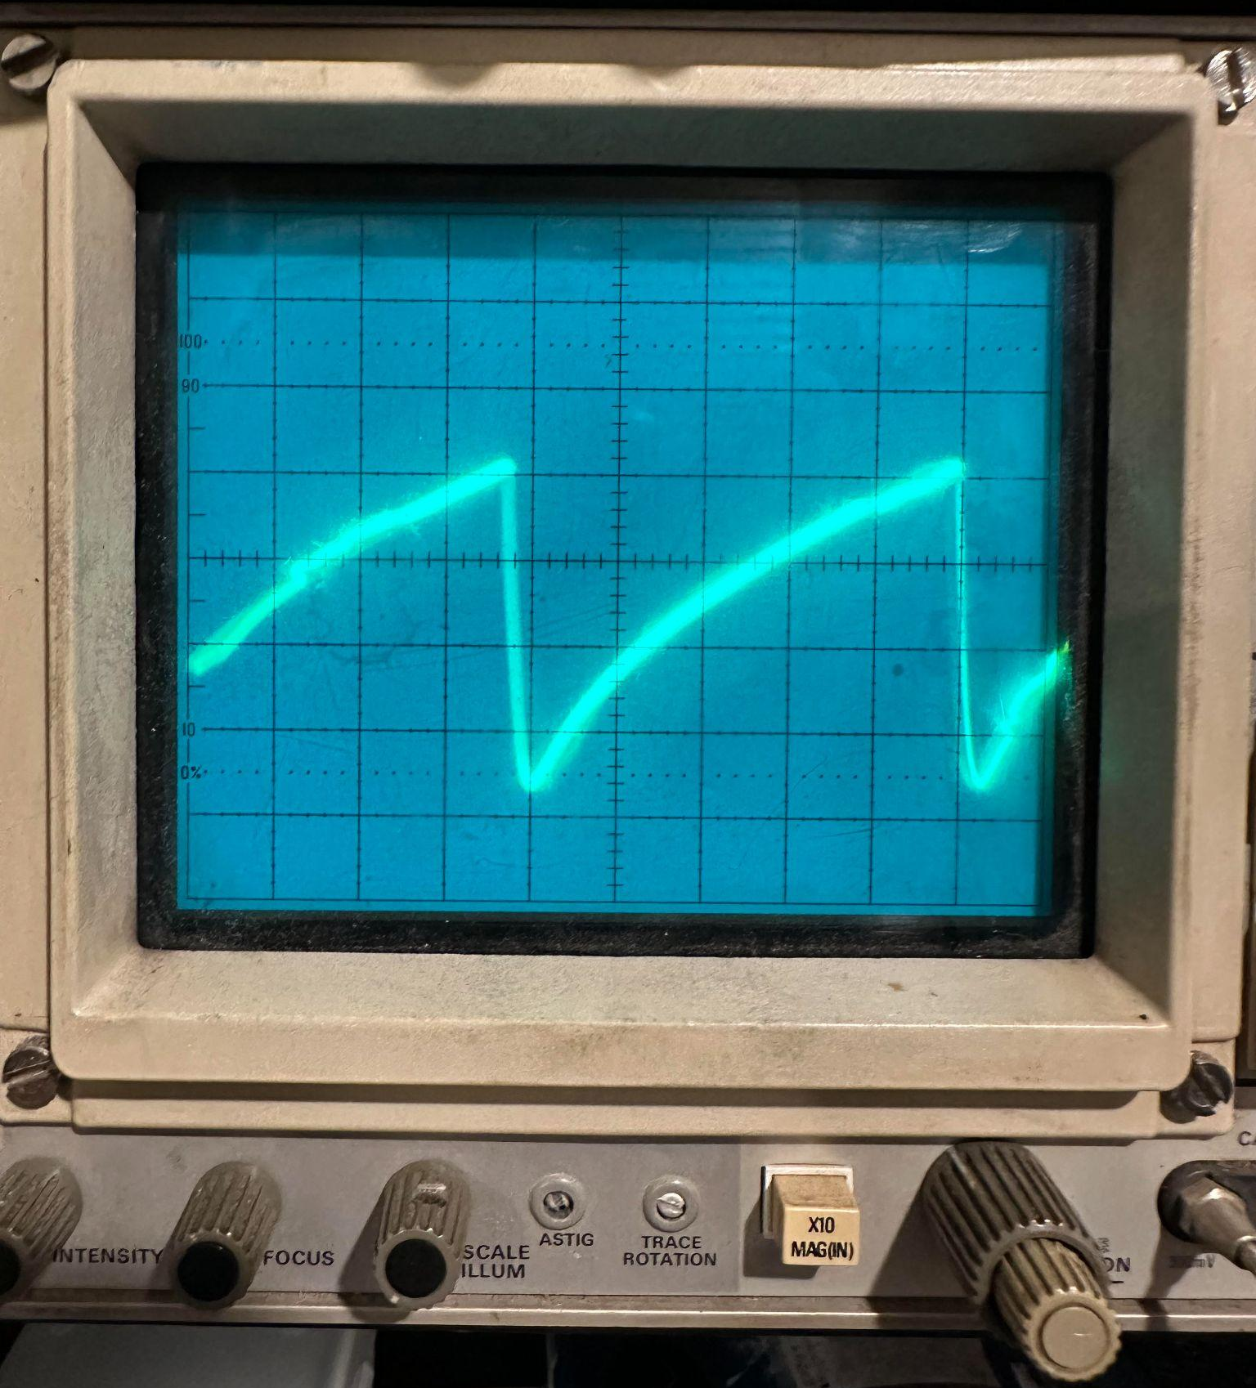
What kind of sounds are we making?
Sawtooth Waves!
Sawtooth waves have a buzzier sound than a sine wave due to its teeth-like shape

Slide 7

What is a Reverse Avalanche Oscillator?

Slide 8
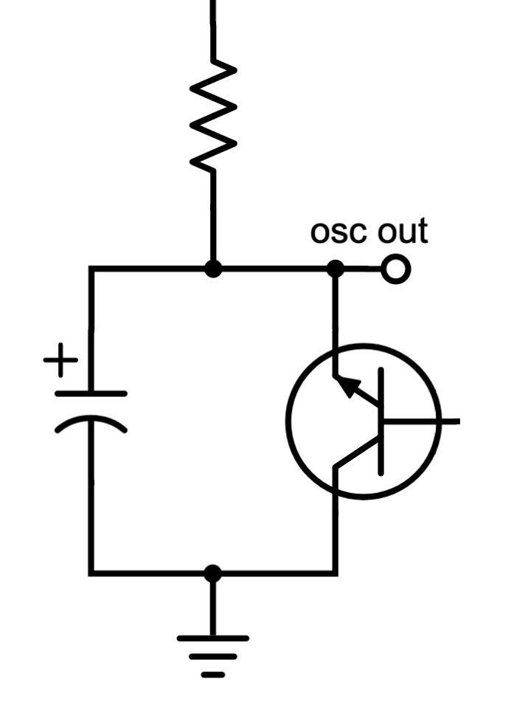
Reverse avalanche circuit

Slide 9
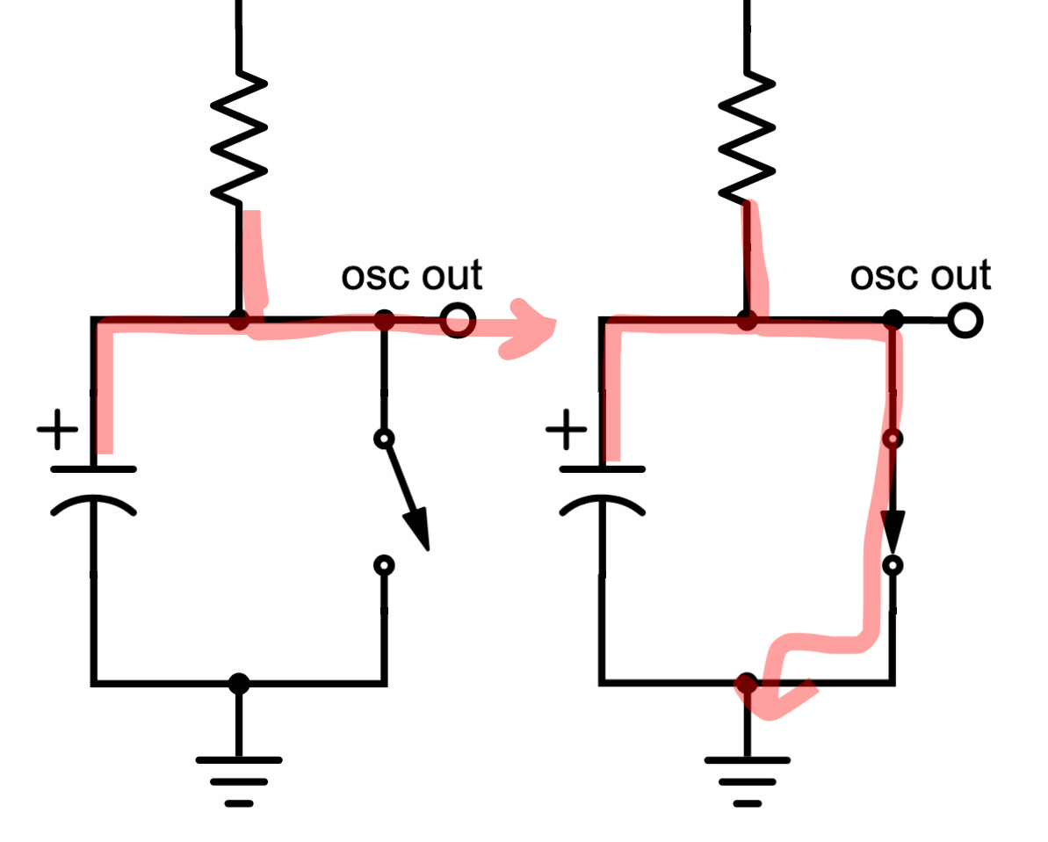
Reverse avalanche detail

Slide 10
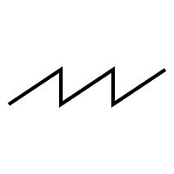
Reverse avalanche detail
HIGH
0V

Slide 11
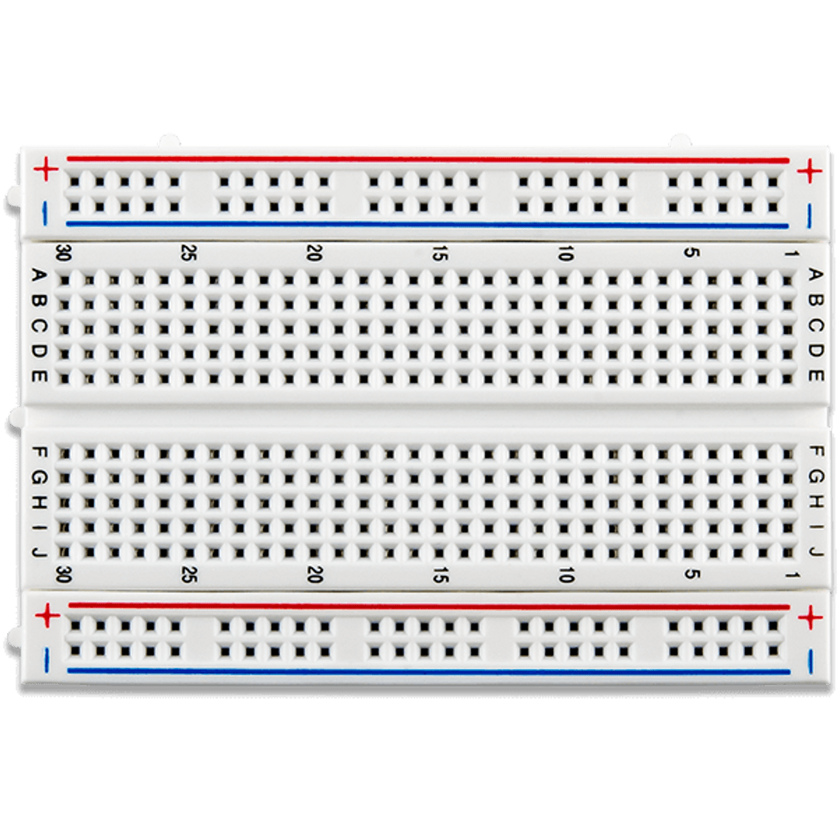
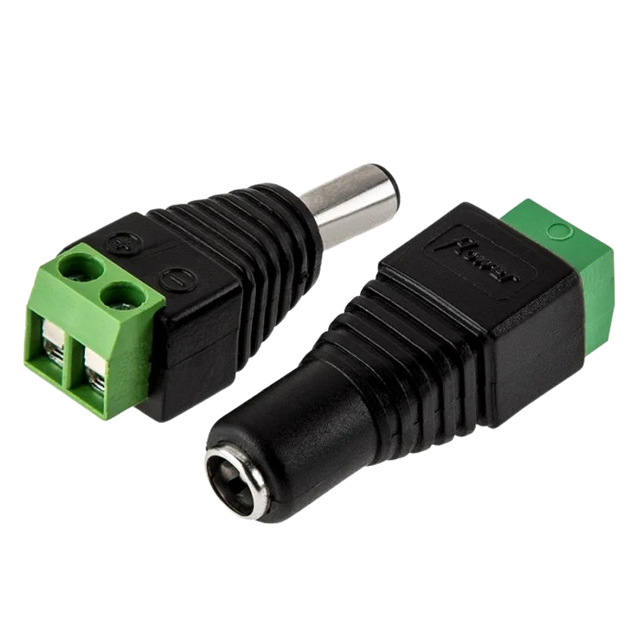
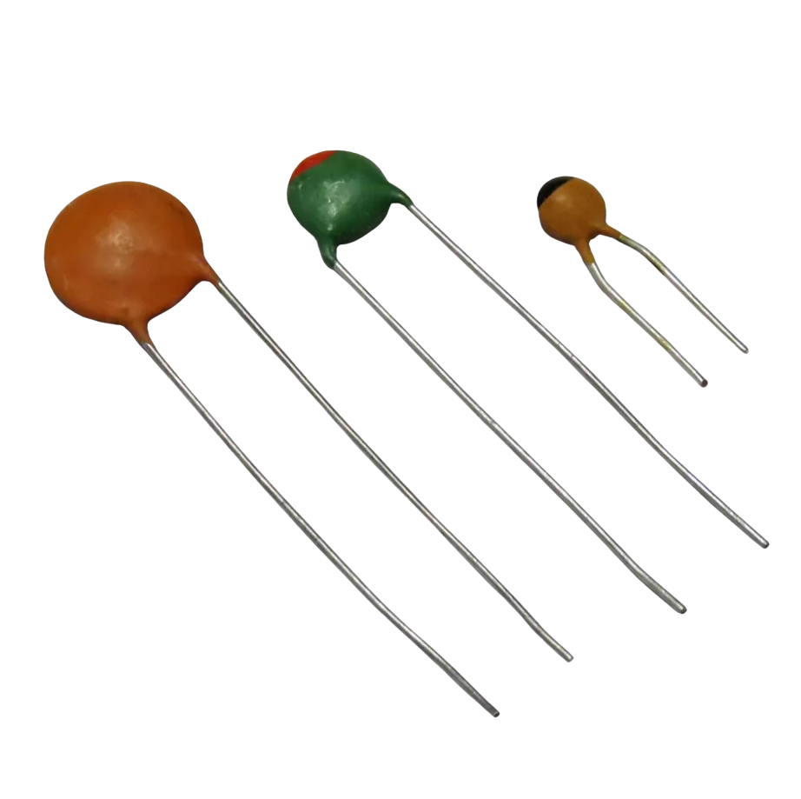
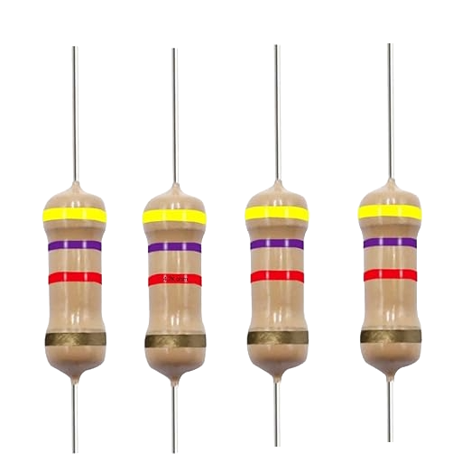
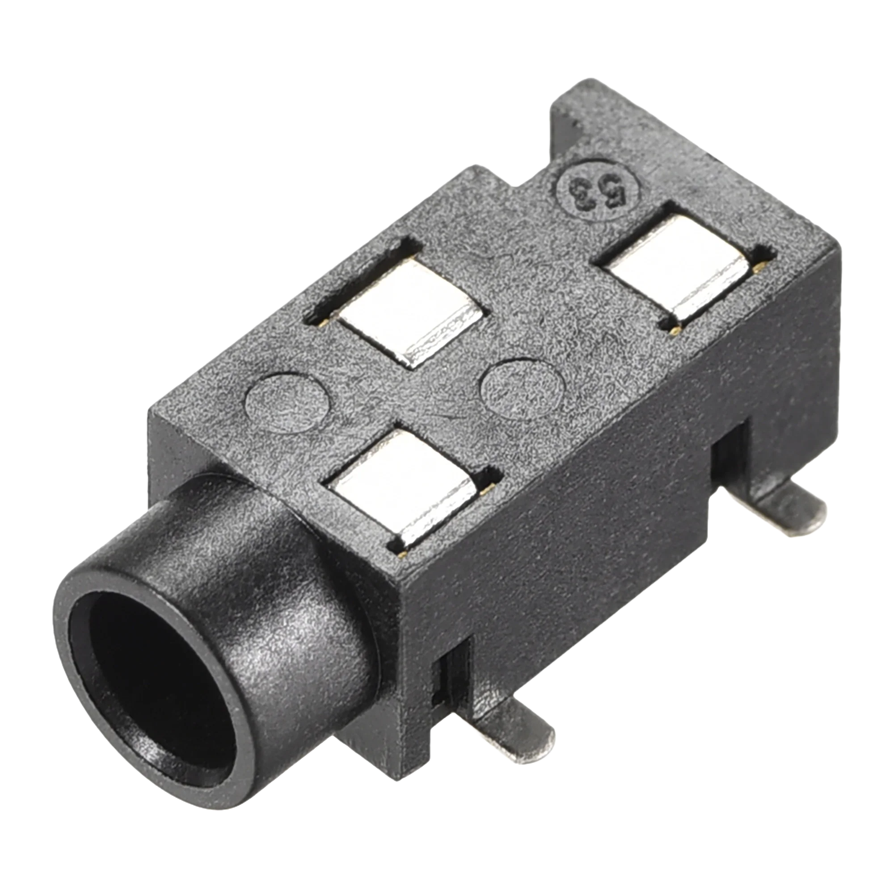
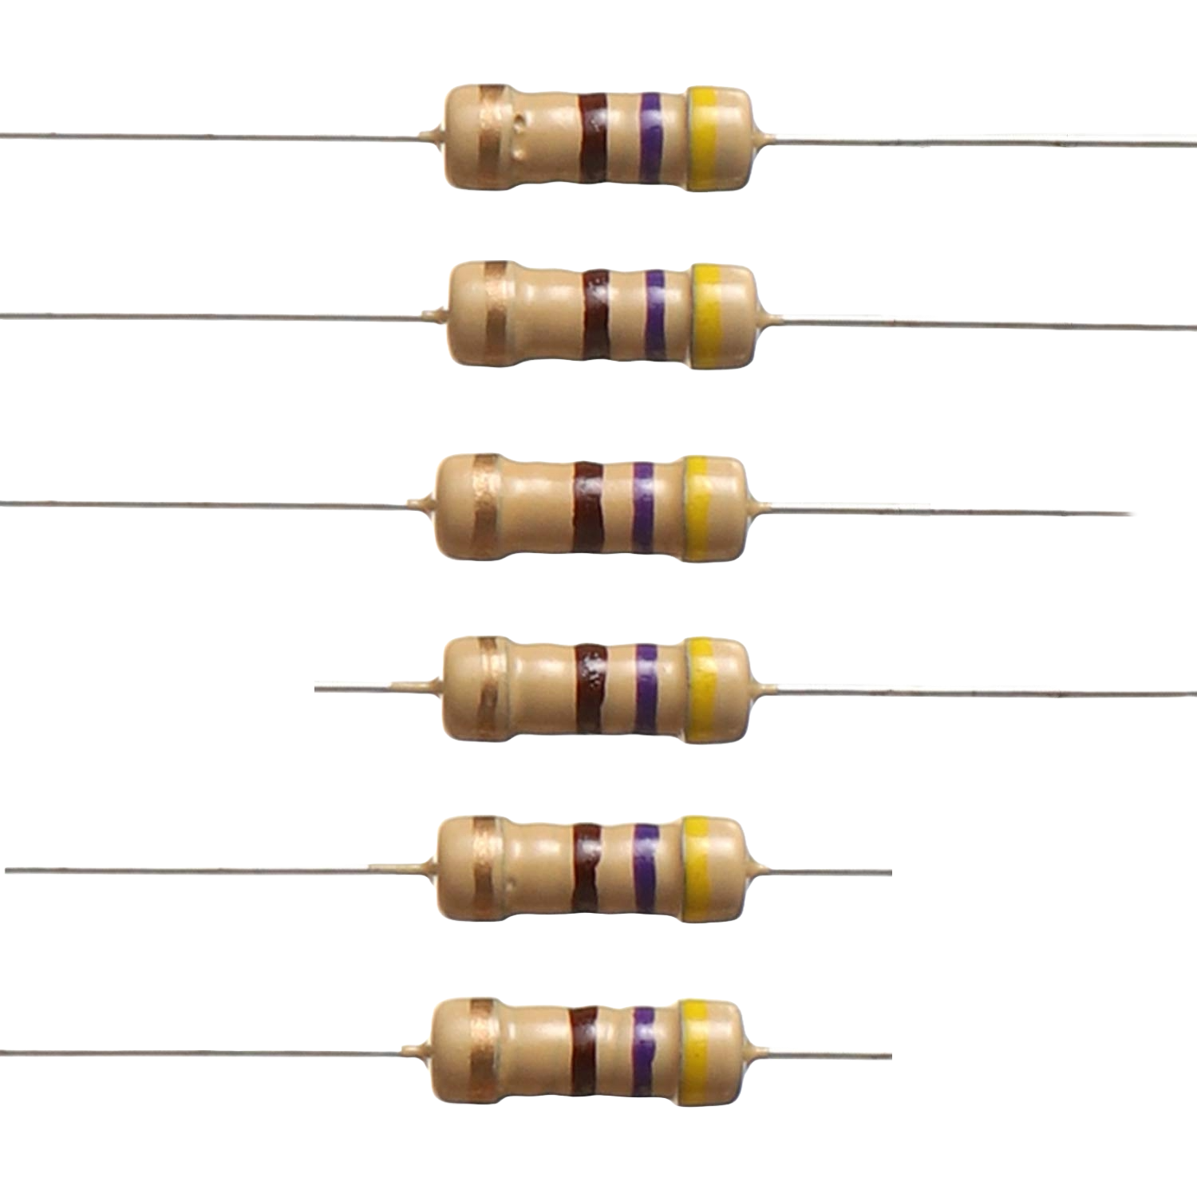
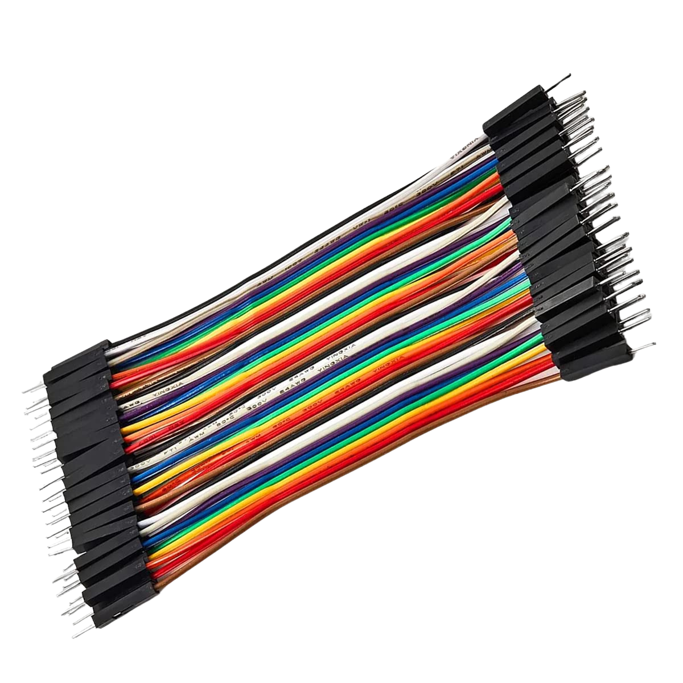
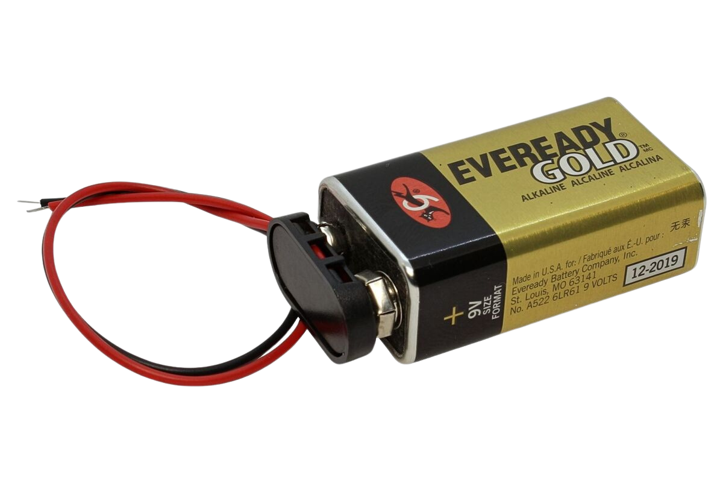
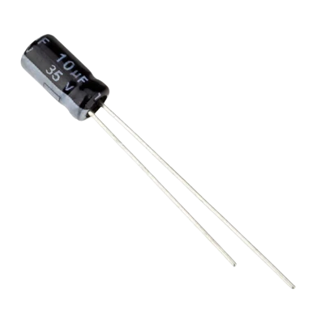
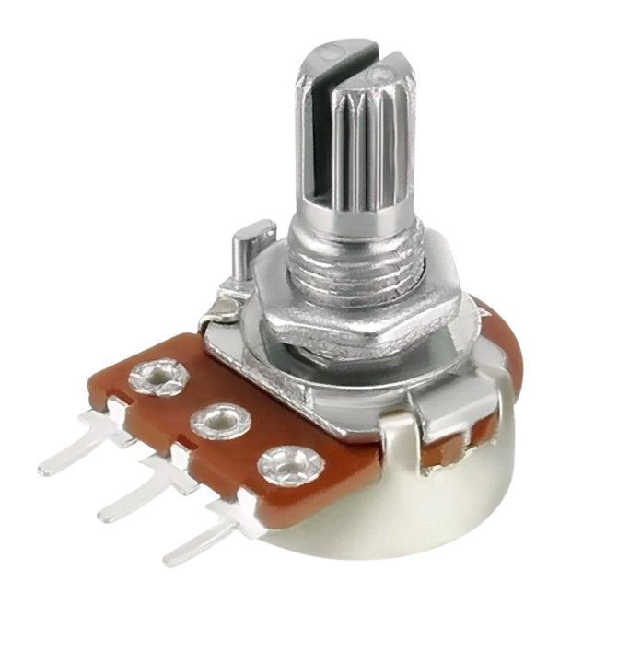
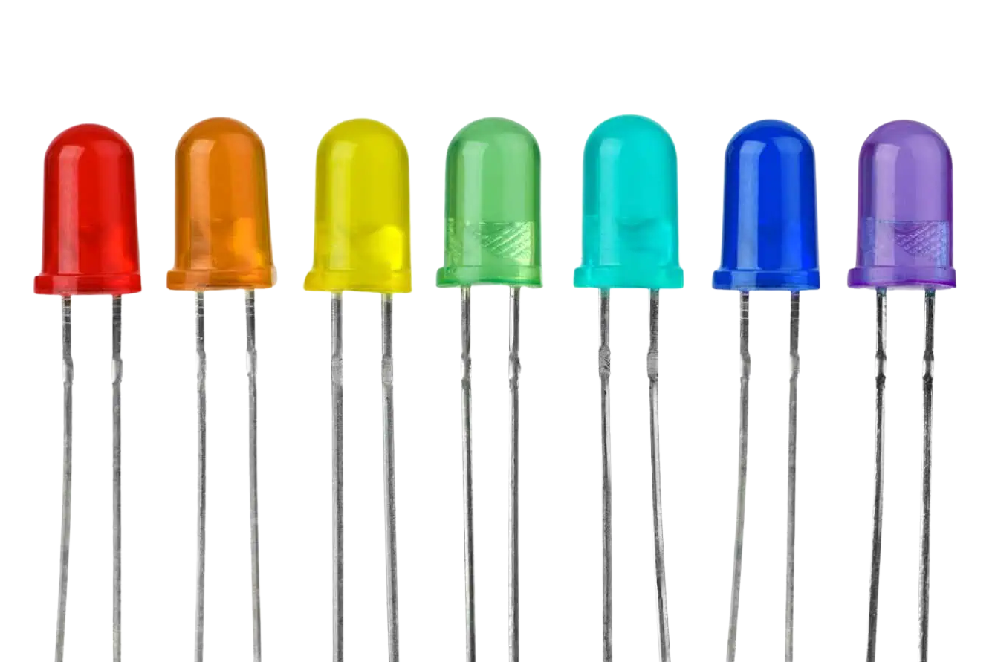
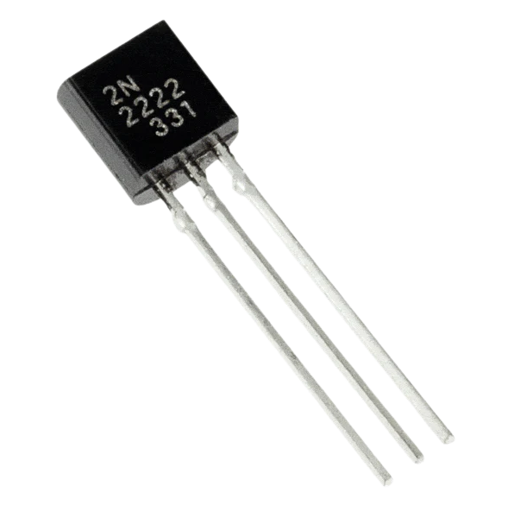
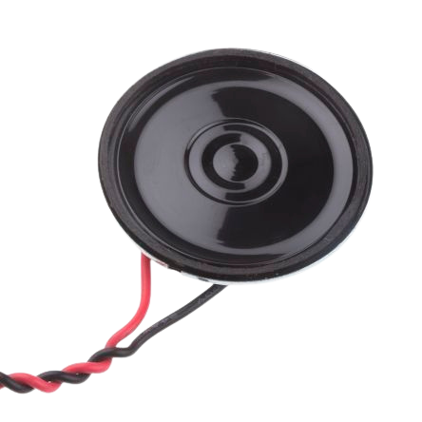
Components and Materials

Slide 12
Resistor
Resistors reduce the flow of current
They are used to control current, divide voltages, time control, and many more!
They are measured in Ohms
Not polarized

Slide 13
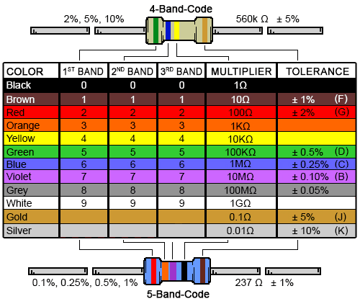
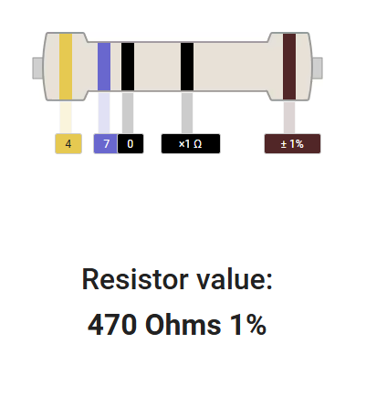
Resistor Bands

Slide 14
Transistor
Transistors amplify electrical signals
They typically have a Collector, Base, Emitter
Emitter is the negative lead
Base activates the transistor
Collector is the positive lead

Slide 15
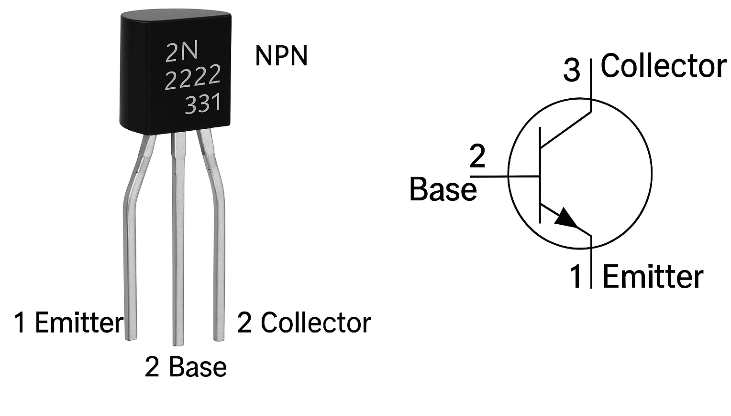

Slide 16
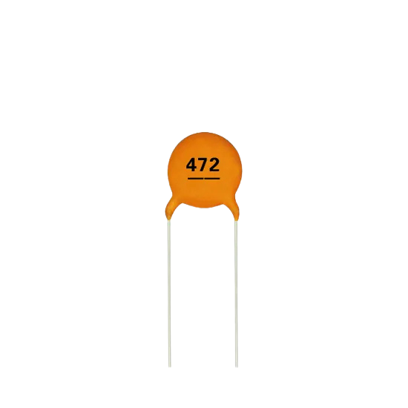

Ceramic Capacitors
Symbol for non-polarized
capacitor

Slide 17
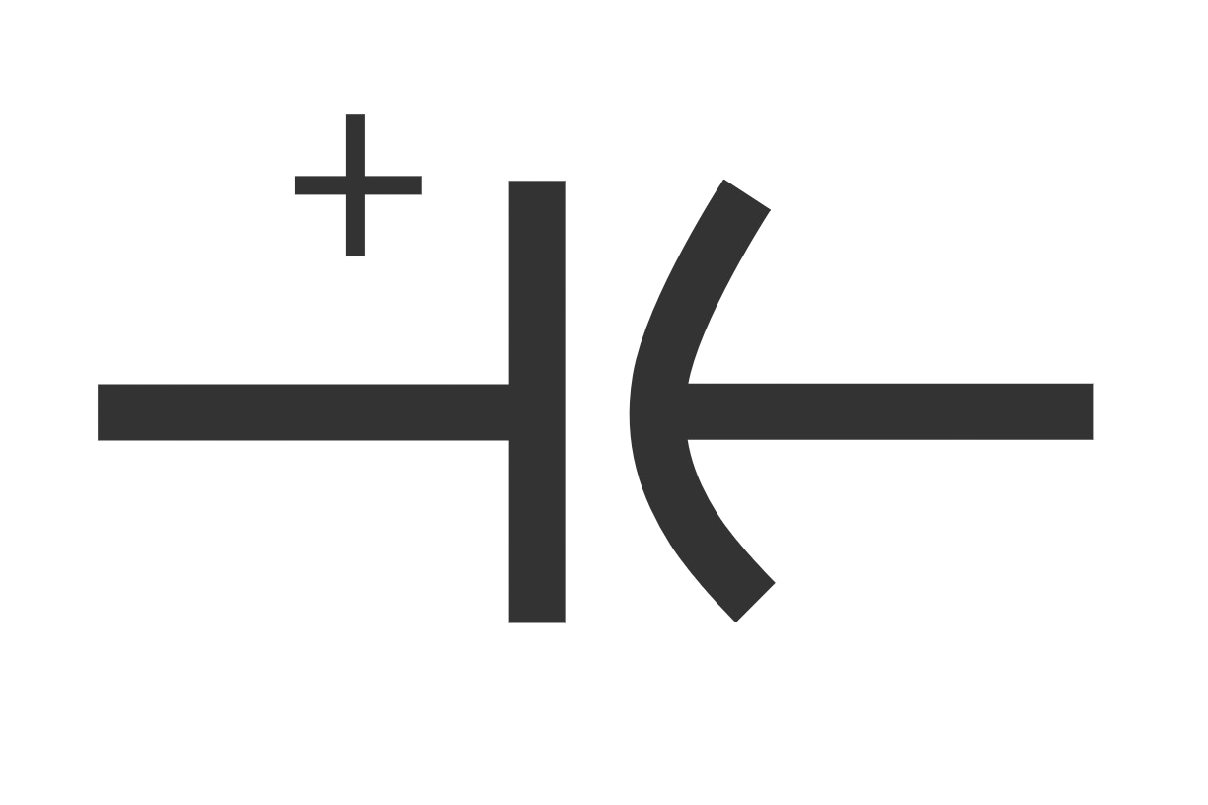
Electrolytic Capacitors
Symbol for a polarized
capacitor

Slide 18
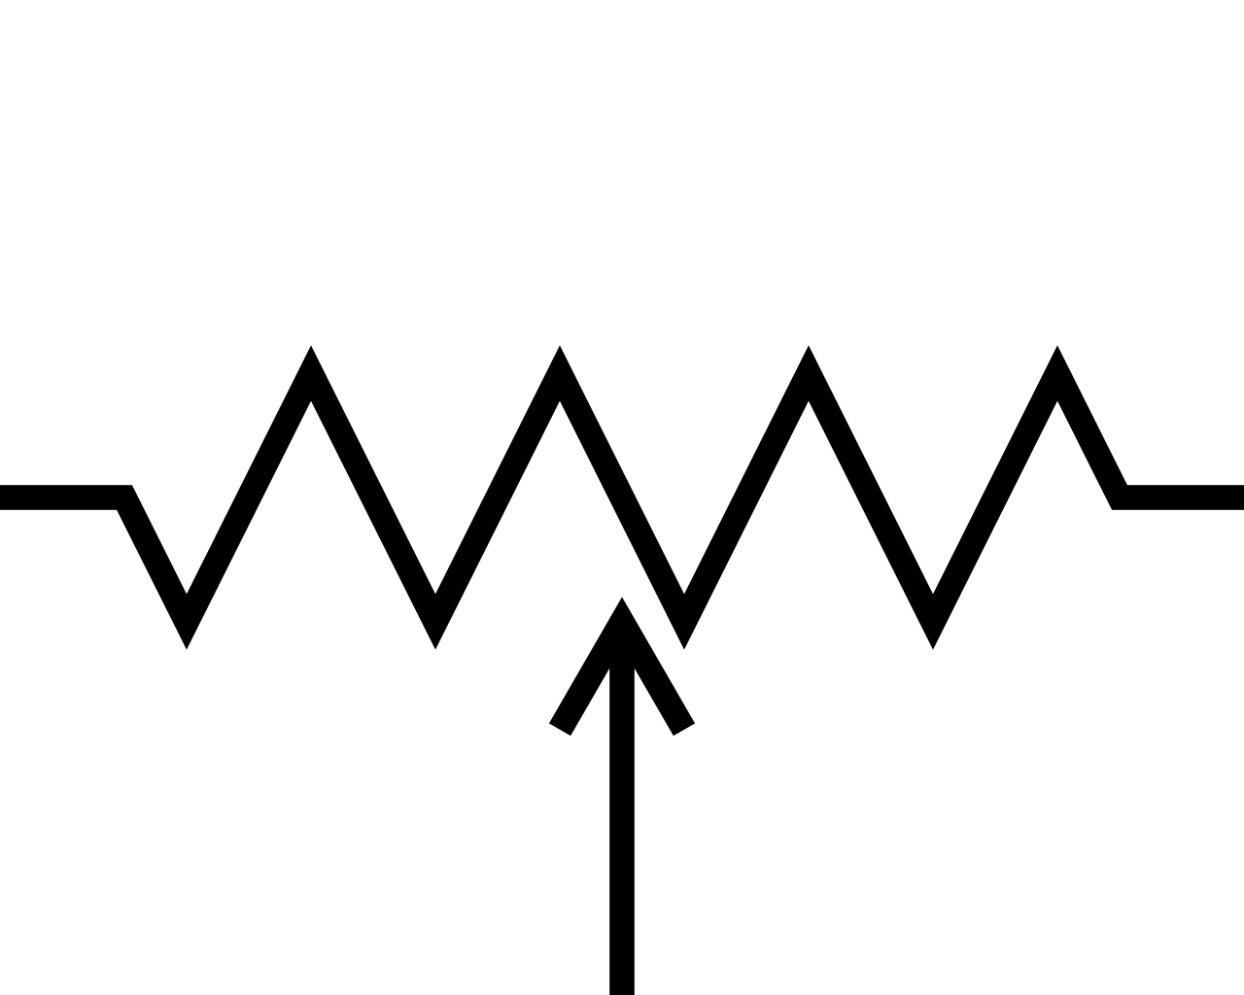
Variable Resistor
aka Potentiometer
Symbol for a variable resistor

Slide 19
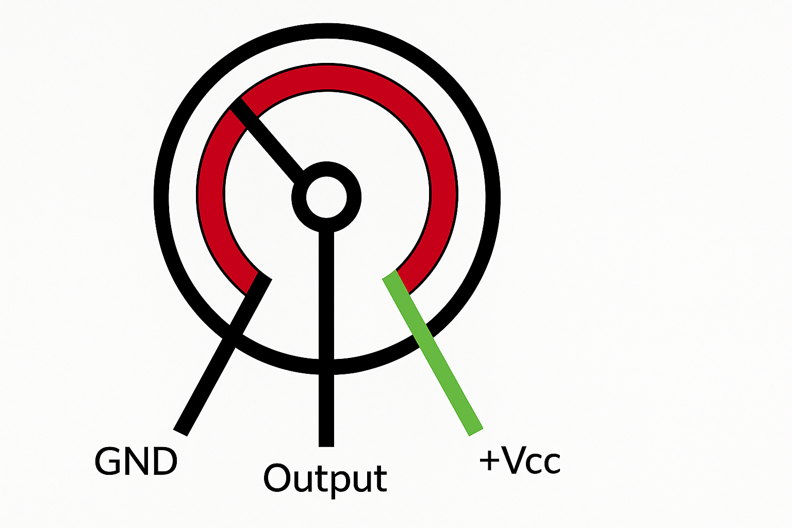
Wiper
Resistive strip

Slide 20
Breadboard
A breadboard is a plastic board with conductive metal channels.
It allows us to build and test circuits without soldering components.
Red rails represents Power
Blue rails represents Ground

Slide 21
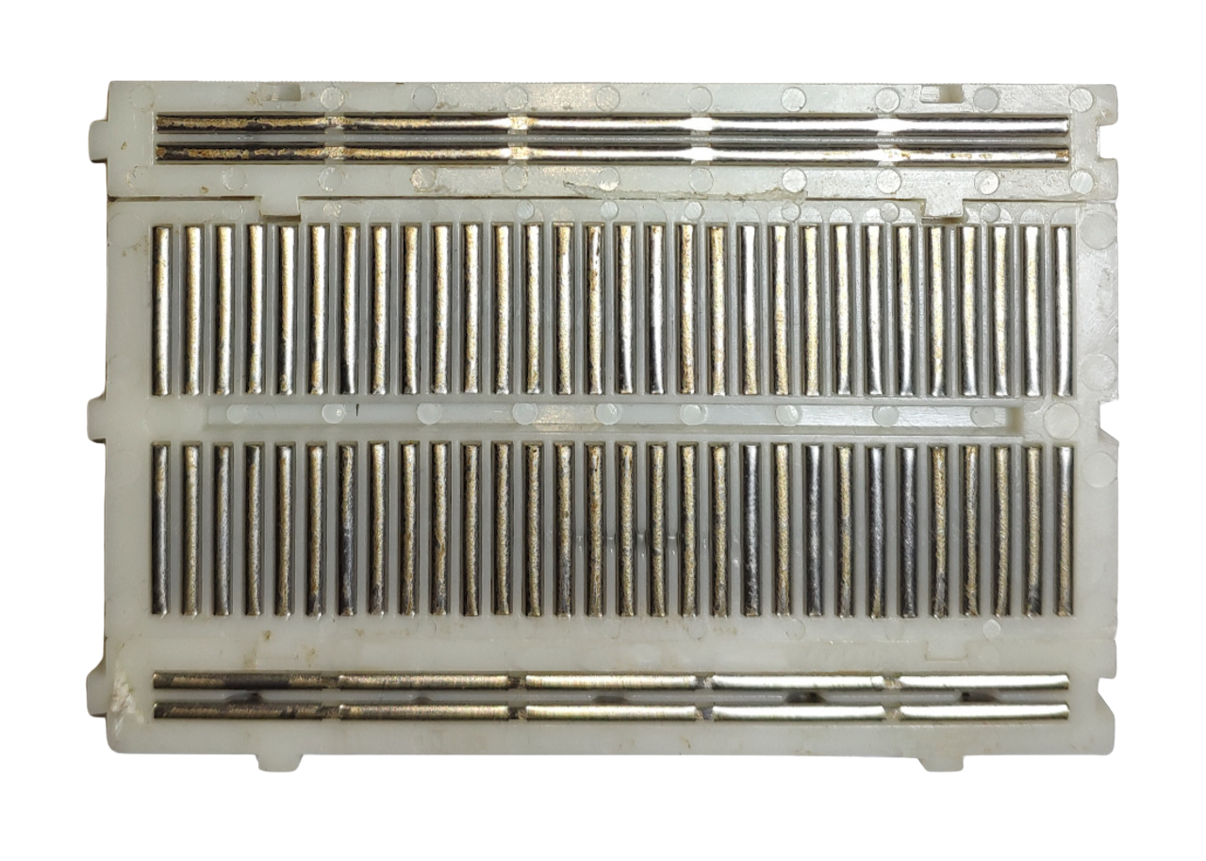
Inside a Breadboard
Power Rails
Component Rails
Component Rails
Power Rails

Slide 22
Vertical holes are linked together
But they are NOT linked
across the divider

Slide 23
Connectors
Jumper Wires
DC Plug Terminals

Slide 24
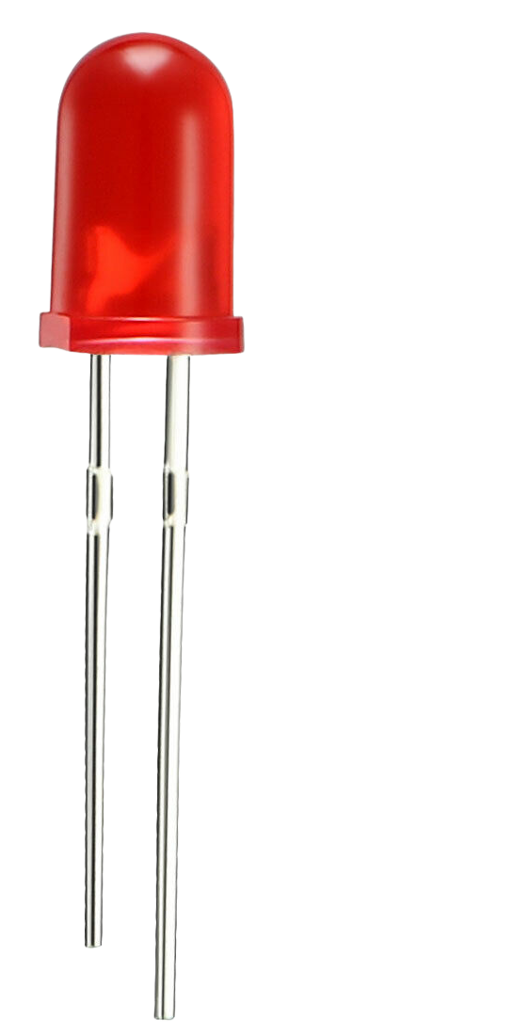
Light-Emitting-Diode (LED)
LEDs are polarized
They have + and - legs
LEDs have one leg that will be longer to indicate the positive leg
Often used to help indicate power is on in circuits

Slide 25
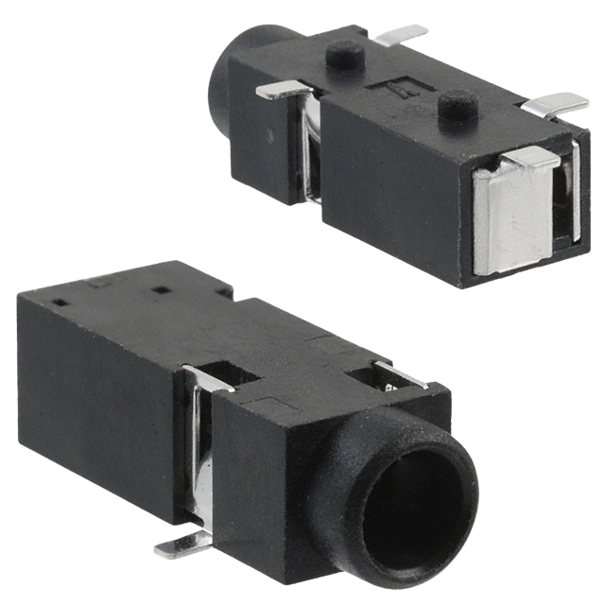
3.5mm Headphone Jack

Slide 26
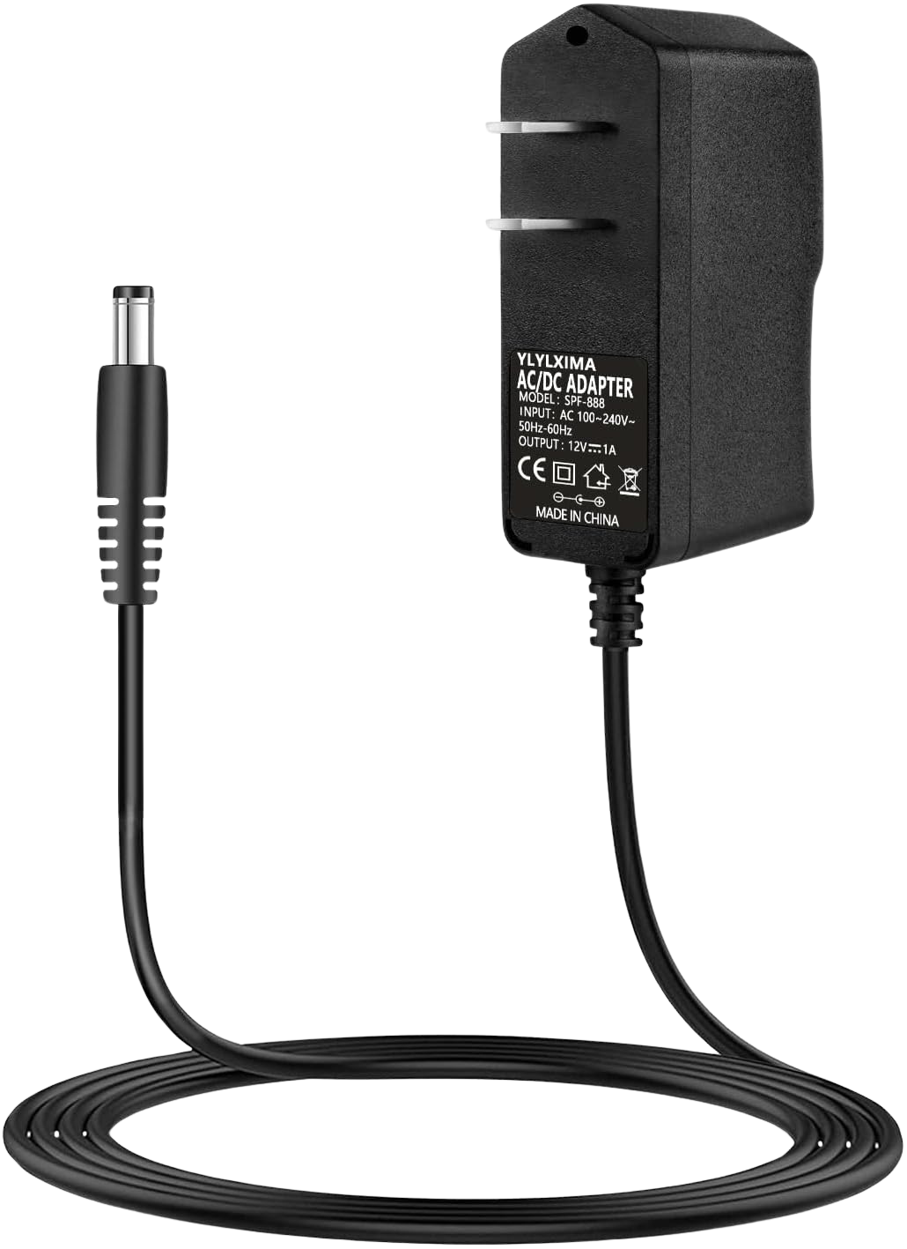
Power
12V Power Supply
9V Battery

Slide 27
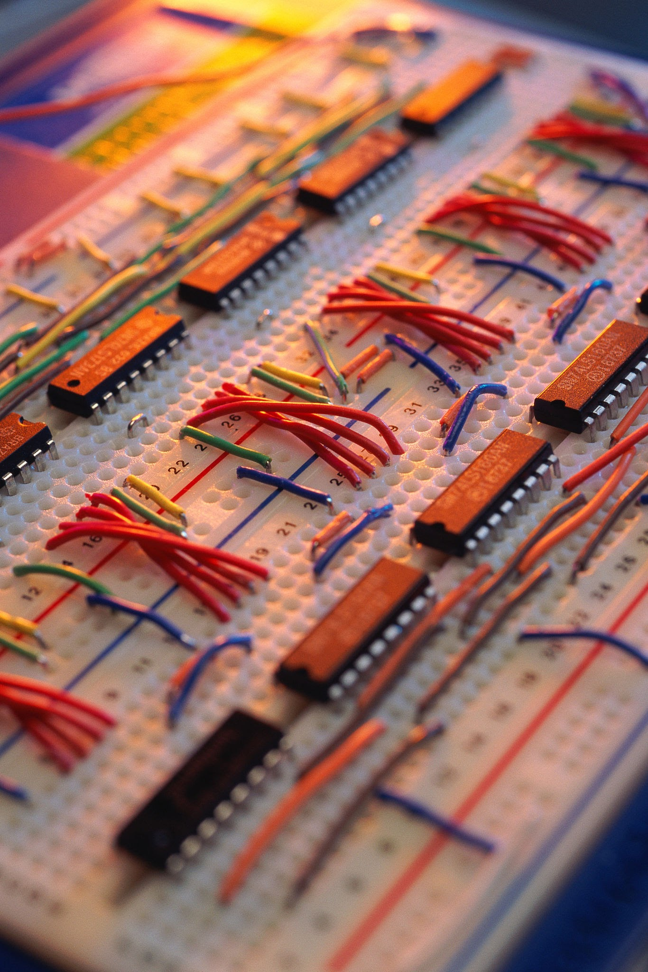
Let’s Build!

Slide 28
Safety Rule!
Make sure to unplug your power when adjusting components.
Plug in your power when you are ready to test your circuit.

Slide 29
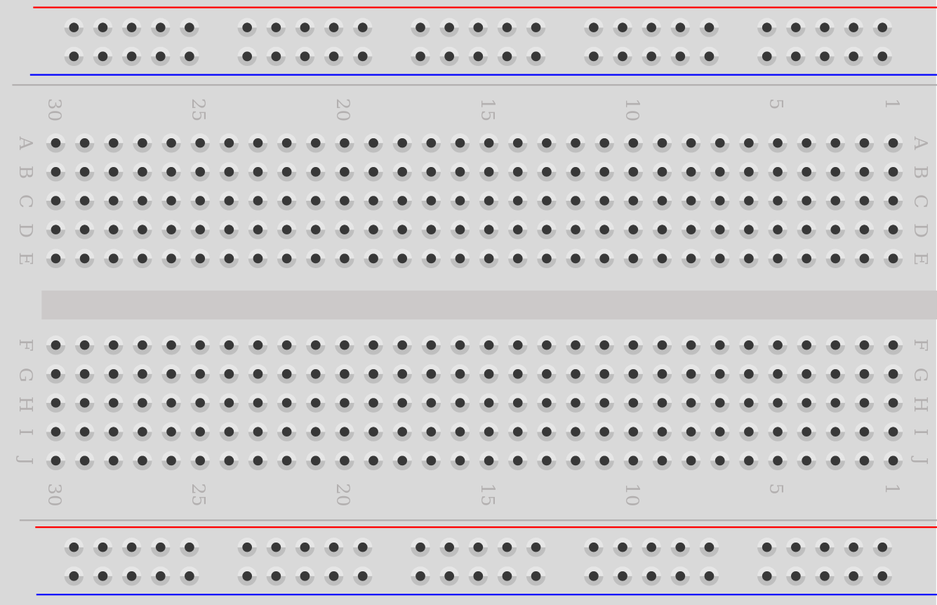
Start with the Breadboard
Power is
the red rail
Ground is
the blue rail

Slide 30
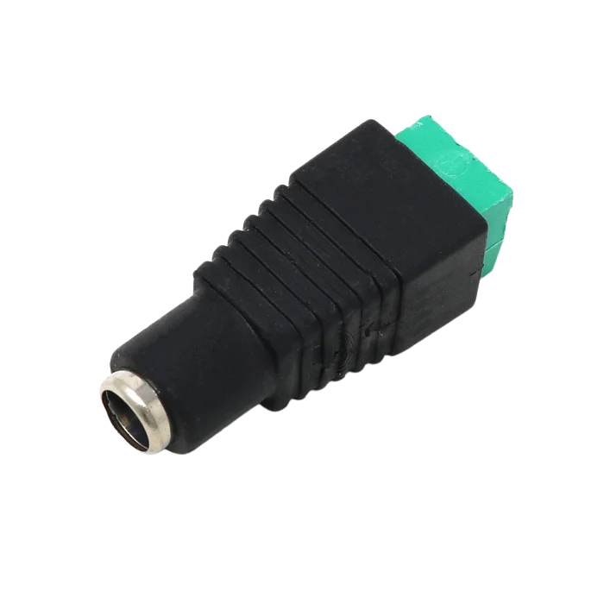
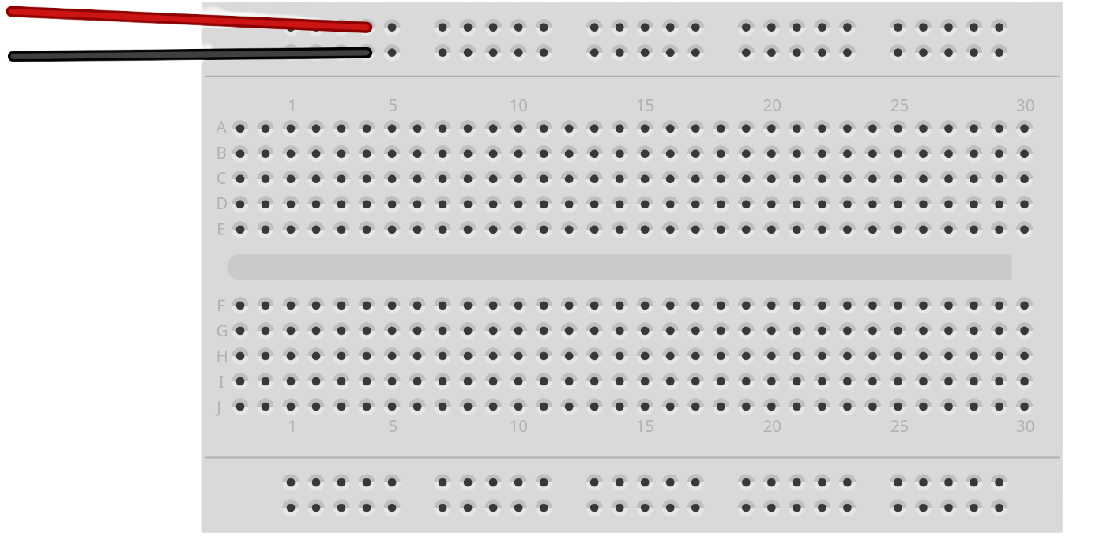
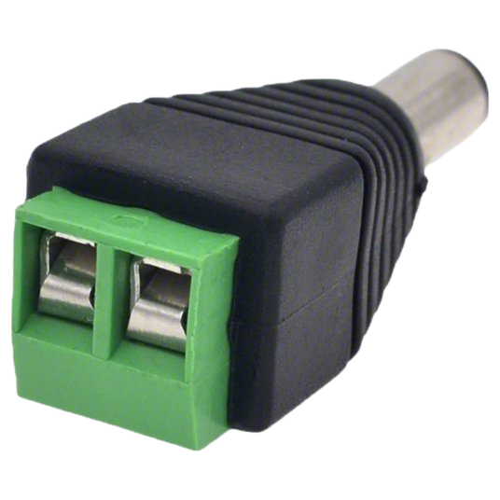
Connect your DC Plugs
Black
or Blue = Ground, – sign
Red = Power, + sign
Insert the wires into the terminals and tighten the screws with a screwdriver

Slide 31
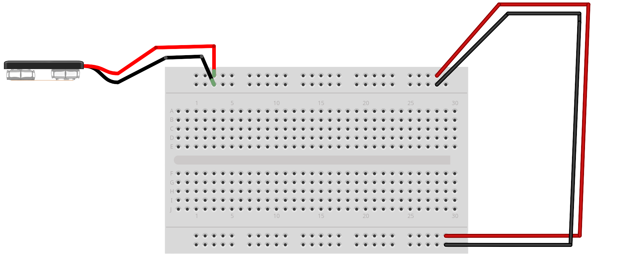
Connect your Power Lines
Red is power = +
Black is ground = –

Slide 32
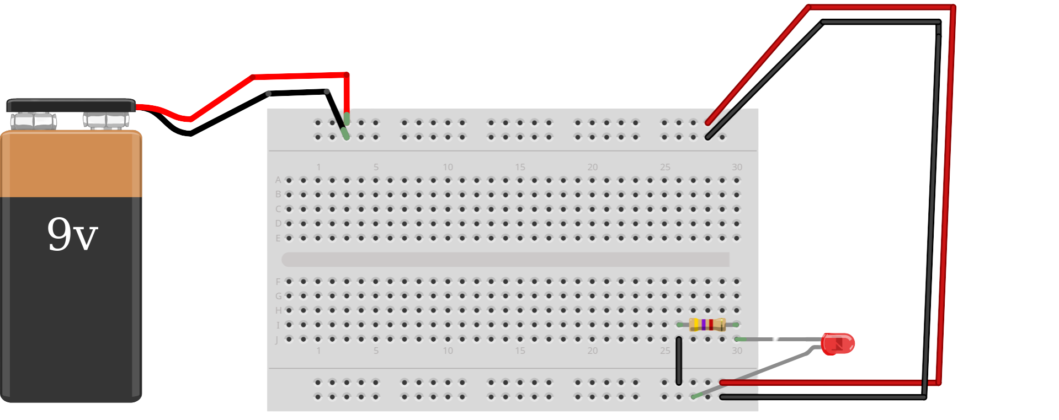
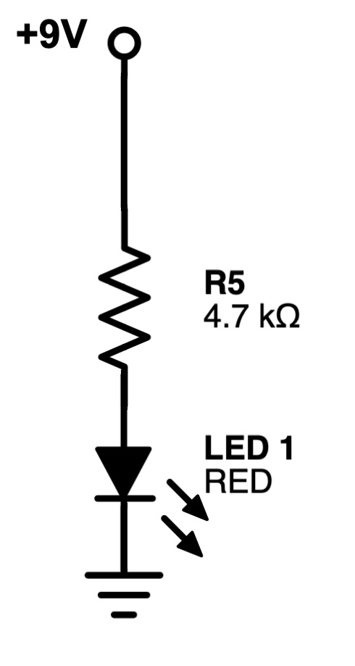
Connect your LED
Longest leg of the LED goes to the bottom rail

Slide 33
Connect your power
Check if your LED turns on!
💡💡💡💡

Slide 34
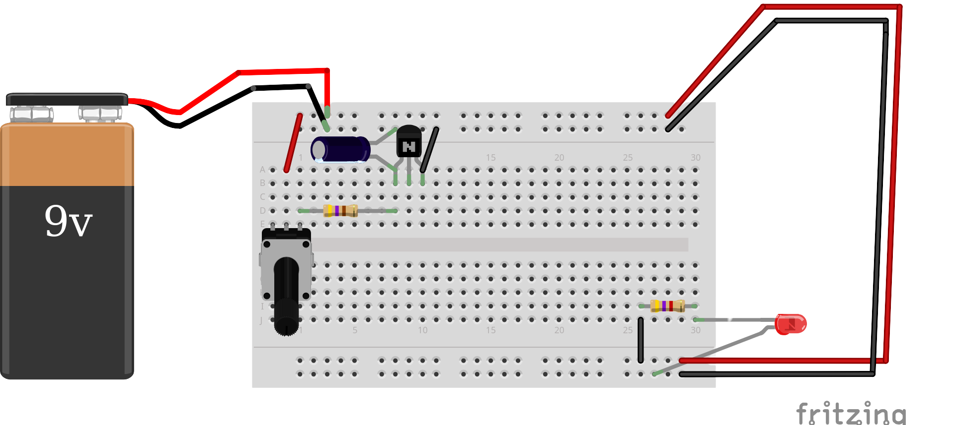
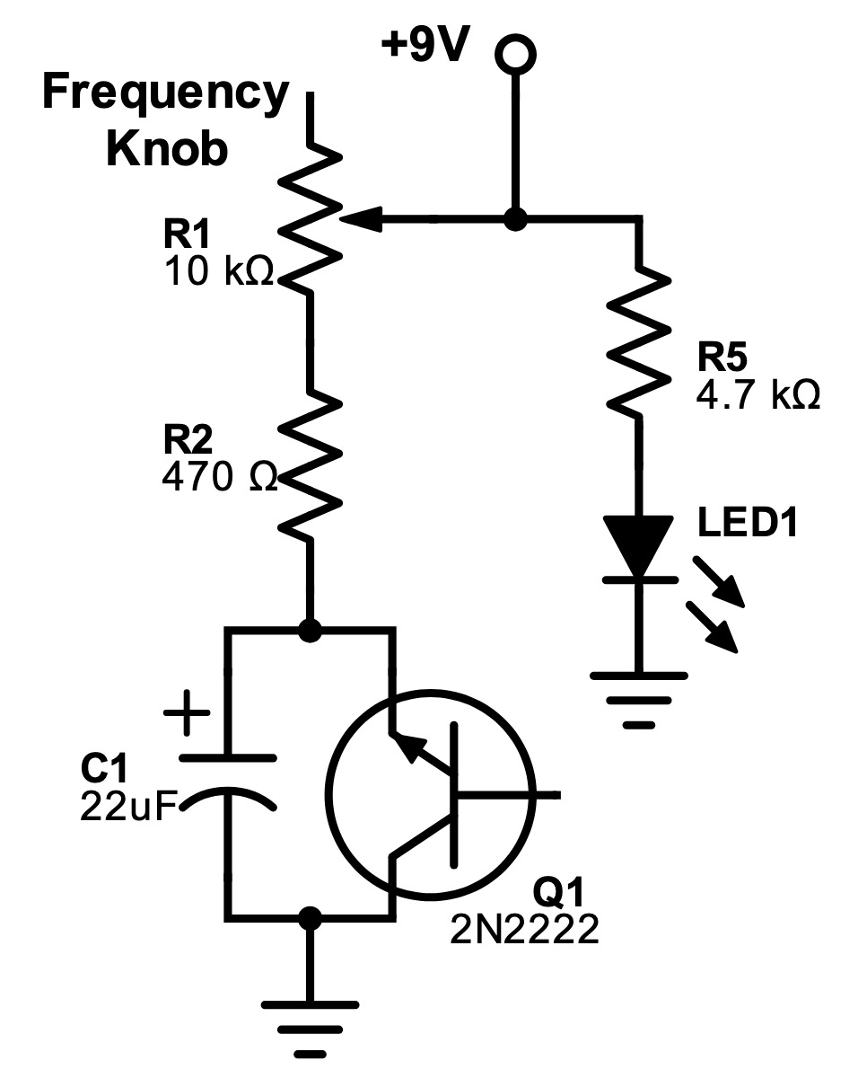
Connect your Oscillator
10k pot

Slide 35
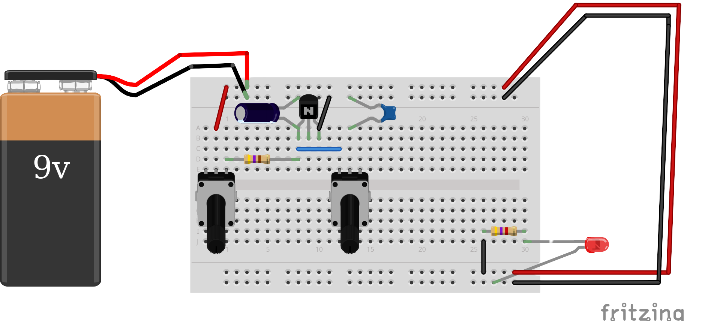
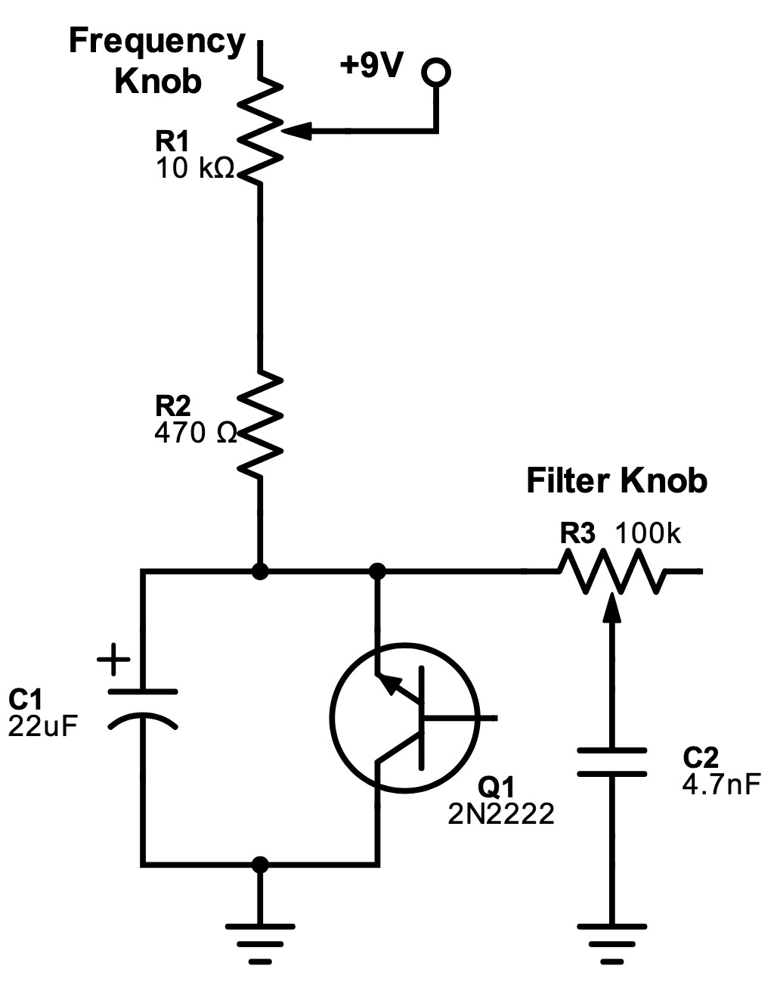
Connect your Filter
100k pot

Slide 36
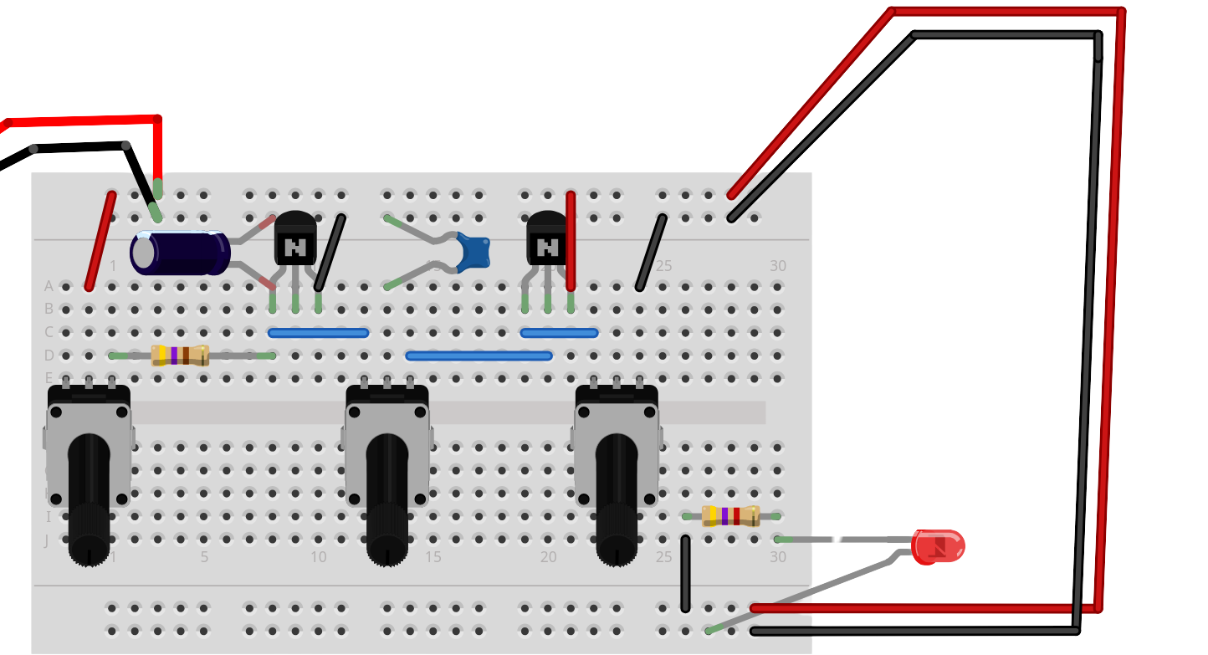
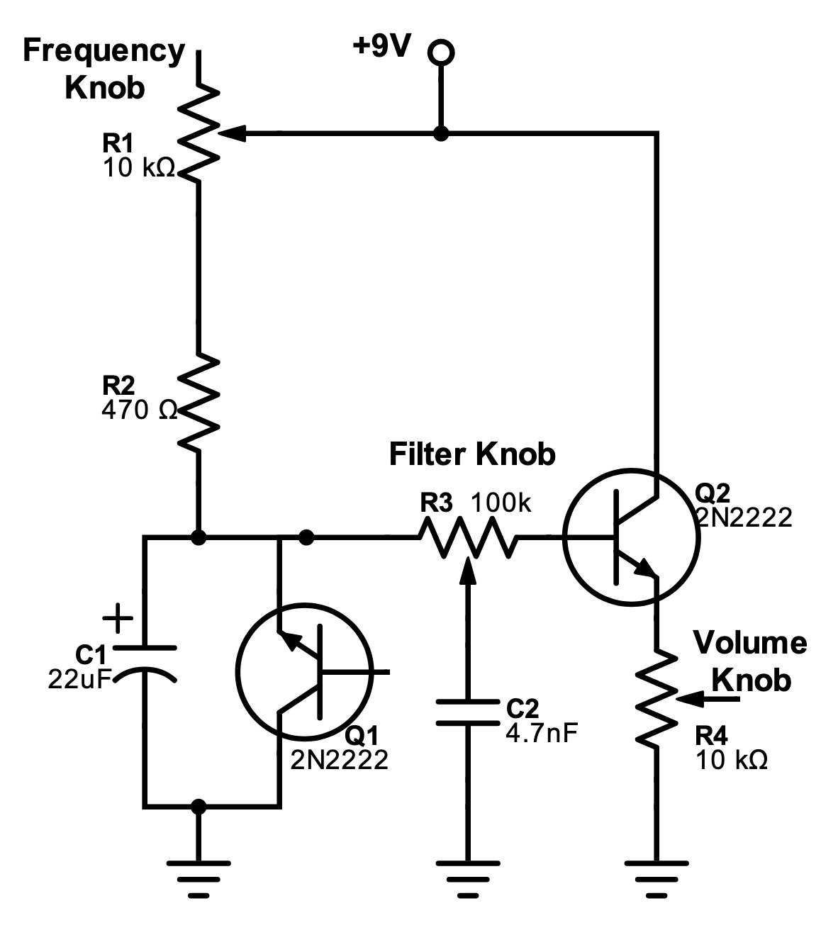
Connect your Amplifier
10k pot

Slide 37
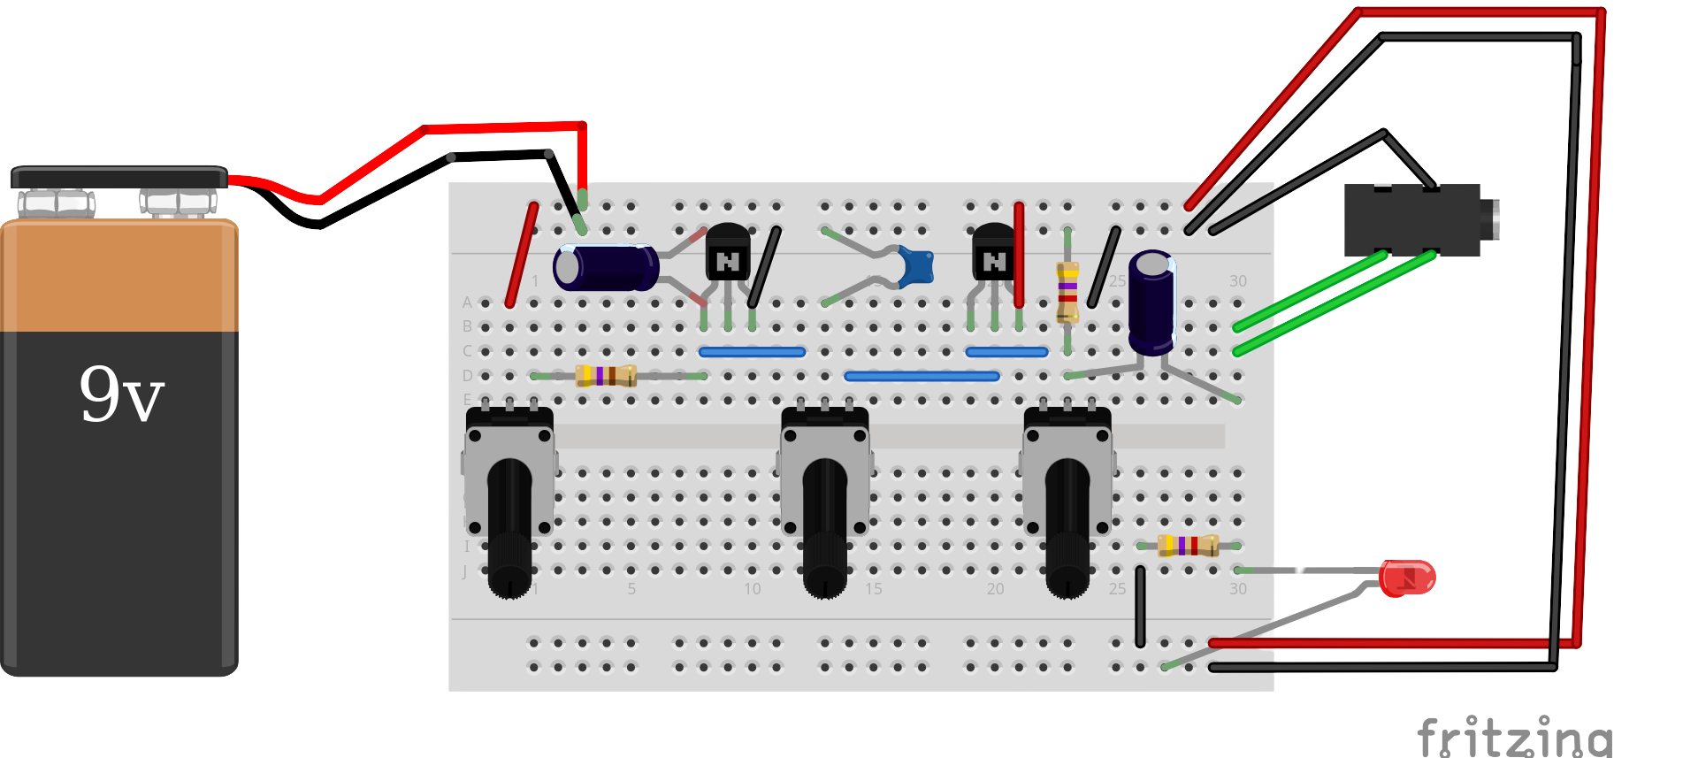
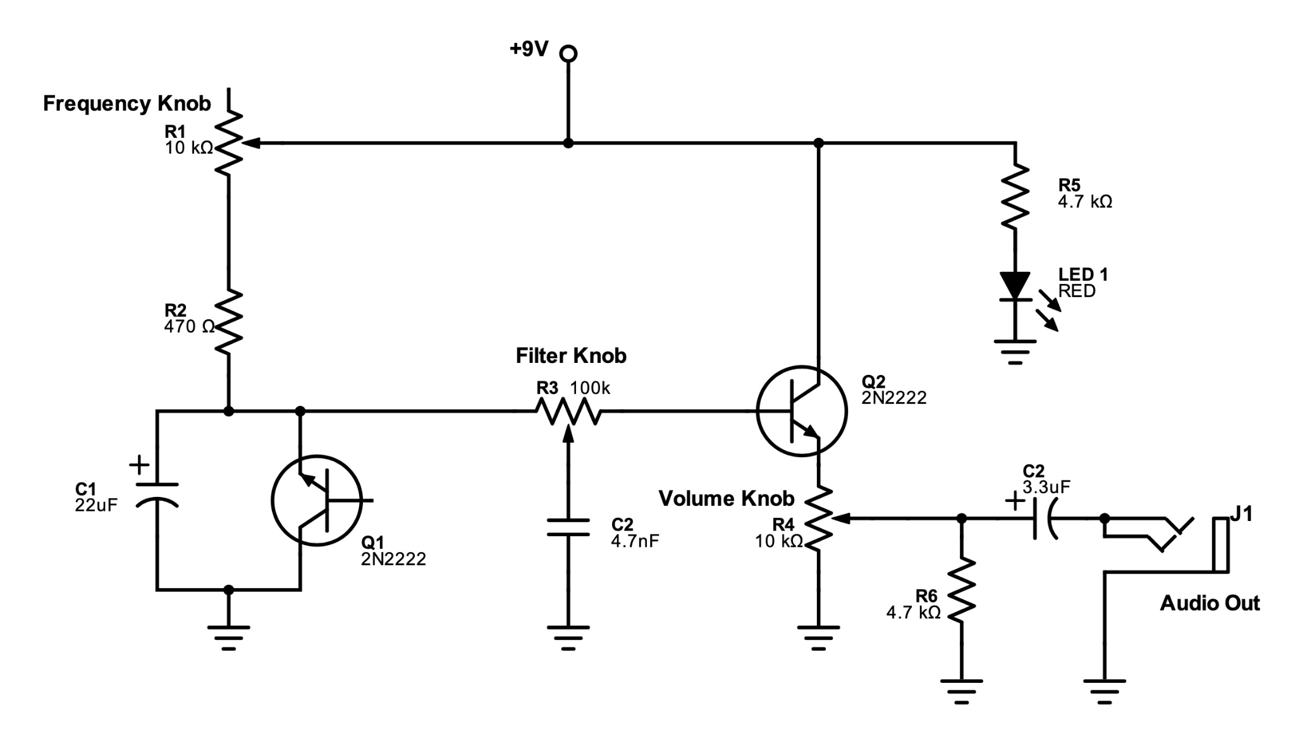
Connect your Output filter &
Headphone Jack

Slide 38
Voila! Your finished synth!

Slide 39
Schematic
C3

Slide 40
Sound Test Time!
Connect your auxiliary jack of your headphones or speaker to your headphone jack
Raise your hand if you need help!

Slide 41

Visit our Github for the workshop reference guide

Slide 42



Connect with us!
Mir Jeffres
Christine Hoang

